Slide 1

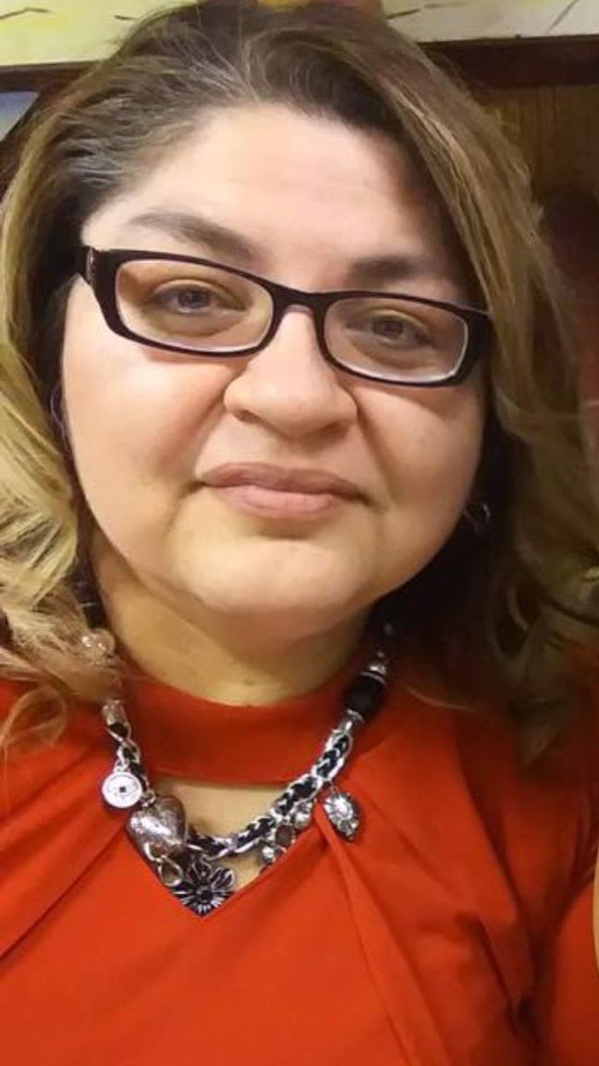
Motivation Education & Training Inc.
Rachel Salazar
Workforce Development Specialist
927 Broadway St.
Plainview, TX 79072
salazar@metinc.org
Office: 806-293-4457 | Cell: 806-494-2050
Rachel Salazar
Workforce Develop. Specialist.

Slide 2





Services
The cornerstone of MET has always been to provide an avenue of self-sufficiency that leads to livable wages for farmworkers.
Career Training
Employment
Pesticide Training available
Housing
Groceries & Gas

Slide 4
MET Programs
CRT: Classroom Training Stipend $7.25 an Hour of training completed.
DPL: Direct Placement
WEX: Work experience, $10.00 an hour, up to 40 hours a week, 12 weeks.
OJT: On the Job Training, reimburse 50% wages for up to 8 weeks to employers.

Slide 5
Who do we serve?
Everyone is encouraged to apply.
Migrant and seasonal farmworkers.
We serve 18-24 MSFW Youth and MSFW Adults.
Dependents of MSFW farmworkers.
Low Income

Slide 6
Required Documentations:
Identification and Social security card.
Proof of farm work performed in the last 12 to 24 months.
Primarily employed in agricultural
Males born on or after January 1,1960 in compliance with selective Service. But will explain
Exception
No appointment necessary.

Slide 7
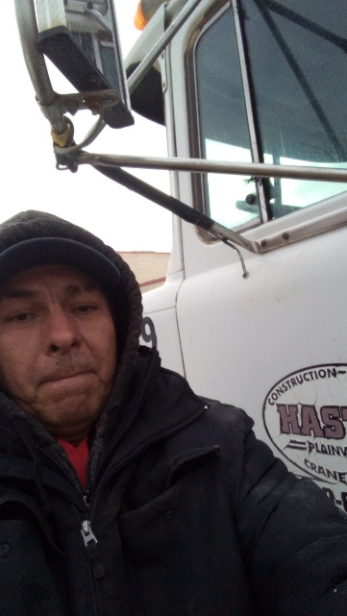
Henry came to us when he hopeful of making something of his future. He had just come out of prison and was looking for a new life.
Henry states that he had a rough start to life. He was given up when he was born. Lived in an orphanage till the age of 7 when a woman adopted him. She did the best she could for him. He was in special ed in school, so he struggled and only went to 5th grade. Unfortunately, he was only able to spend 10 years with his adopted mother. Henry states that she died when he was 17 years old. Because of the heartbreak, he lost himself in drugs and alcohol. By the age of 20, he found himself in prison and this last time went in for 23 years.
Upon release of prison, he decided that it was time to do something good. That is when he came to us seeking change. Henry is a single individual with no dependents. He has 1 year Ag work experience. Henry stated that he was ready and needed this change. After review of the Intake, he was deemed eligible for MET services. Henry enjoyed attending training and had no problems. He obtained his CDL on February 2, 2021 and is now working as a truck driver for Hasty Trucking earning $12.00 per hour. His total pre-program earnings are $1,211.00. He is now making $5,760.00 per quarter.
Henry Balderas - Truck Driver
Plainview, TX
Success Story

Slide 8
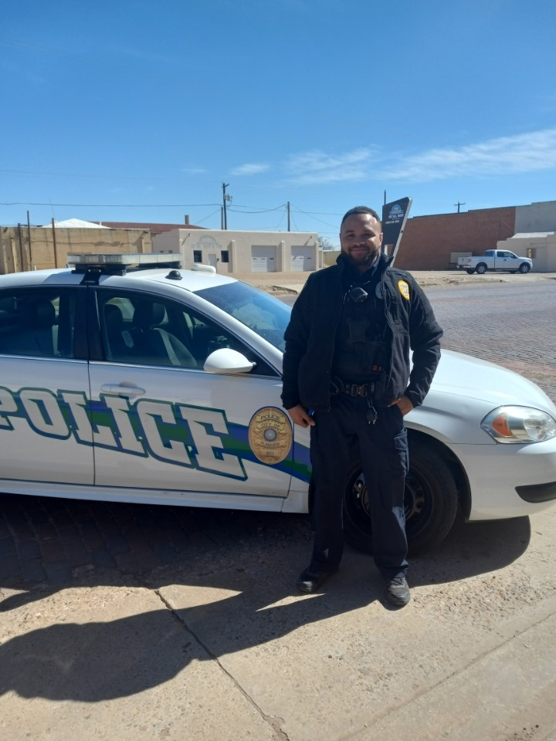
Warren came into our office because he was referred to us by a Plainview Officer named Jaime Salinas. He was interested in becoming a Police Officer and once he became one, he had to go work at the Lamesa Police Department because there were no openings at the Plainview Police Dept. Because of that, we had a hard time getting a hold of him. We did our Follow-ups by calling the Police Department. Warren was working the night shift at Lamesa, and it was very hard to speak to him since he slept all day.
Warren and his mother were at a bad point in their lives and lived at a motel barely making it. Even though his mother was struggling she was soon able to secure an apartment at Date Street Housing. That is where Warren met Police Officer Jaime Salinas. Jaime eventually became a mentor to him and encouraged Warren to become an officer. Warren had never thought about becoming an officer, but he said that because Officer Jaime kept encouraging him, he started to think about it. After one of his conversations with Jaime about it, Warren mentioned that even if he was to go to training, he did not have the money to pay for it, that’s when Jaime told him about MET.
Warren stated that he was taking care of his mother after she became ill with stage 4 cancer all while he would go and work out in the fields to hoe cotton, pick pumpkins, tarp cotton modules and fix irrigation systems. After meeting Jaime and getting that encouragement from him to become a police officer, Warren decided to inquire about the training and that’s when he came to us. He was given a list of documents and upon reviewing the Intake, he qualified for the program. Warren was excited to start his new chapter is his life.
Warren started training on January 3, 2020, and completed on September 25, 2020. He stated that he enjoyed every part of his training and had no problems while in class. He passed all his test and was excited but also nervous to take his final exam, but he passed and felt like he was finally on his way in life. Warren also stated that at the swearing-in ceremony he felt so proud of himself and so did his mother who was able to attend the ceremony. He states that he was ready to start his new career and hopes to one day advance to S.W.A.T. Warren is doing very well now, he started working at the Lamesa Police Department in Lamesa, TX on October 5, 2020, but as mentioned has since transferred to the Plainview Police Department.
After we found out that he had started working at the local Police Department, we asked Warren to come in. He was able to do so on January 5, 2022, and so we spoke to him and got his story on how he decided to go to basic training for a peace officer and the struggles he had before that decision.
Warrens pre-program earnings are $8,544.00. He is now earning $9,600.00 per quarter. We are so very proud of Warren and look forward to seeing him advance in his career.
Warren Flye
Plainview Police Officer
Success Story

Slide 10


Slide 11
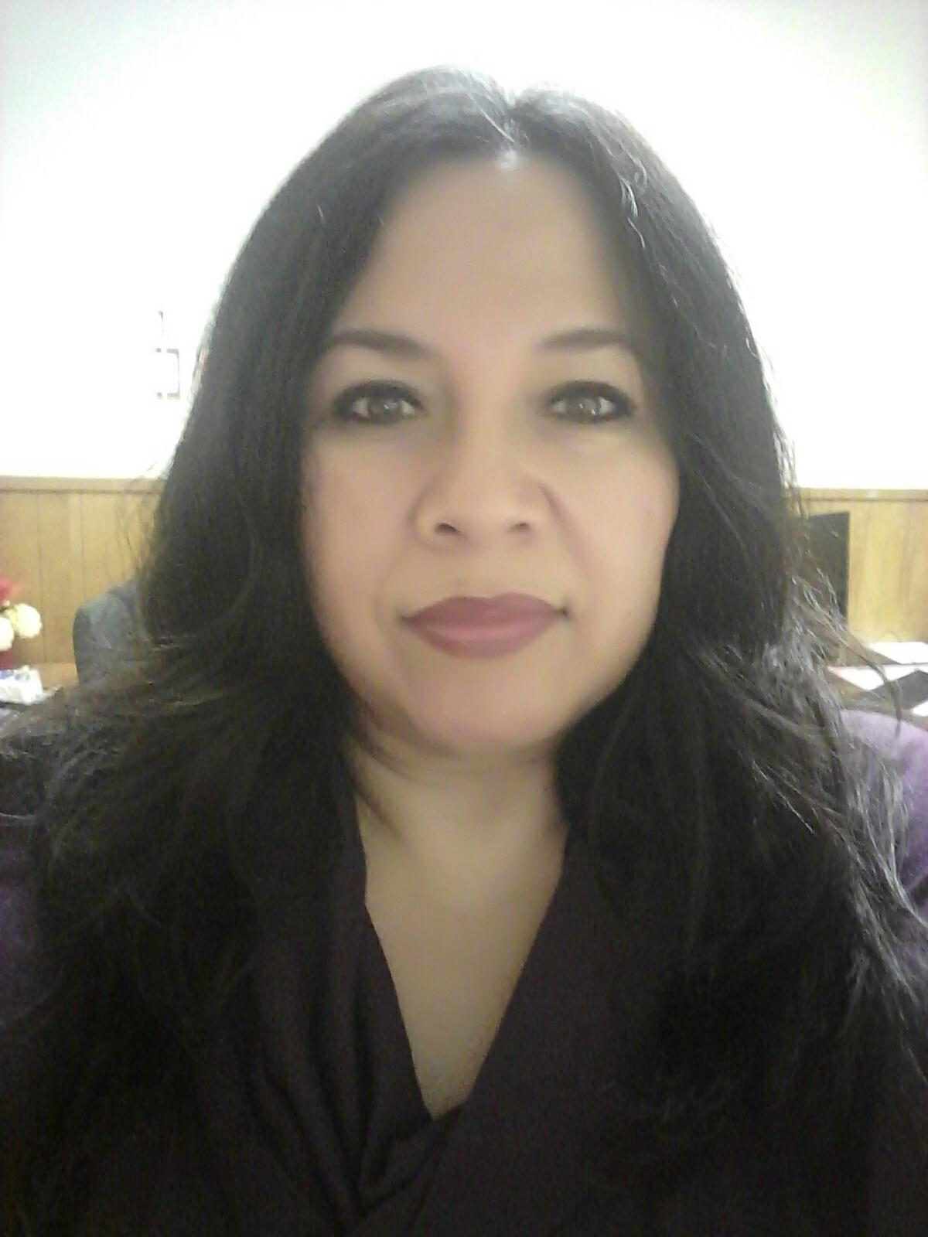
Plainview, TX
Staff
Our Plainview office coverage in which we locate and identify farmworkers through all surrounding areas: South Plains, Panhandle & Premium Basin.
Gloria Zapata
Client Service Rep.

Slide 13
MET Collaborates
Organizations
Workforce Solutions in the Region
South Plains Community Action
Panhandle Community Service
Migrant Programs Schools within Regions
Guadalupe Economics
Salvation Army
Crisis Center
Various Homeless Shelters
And anymore resources we can find when a client has a specific need.
Organizations
TRLA
Family Support Services
Texas Aglife Extension
Lubbock Dental & many more….
Colleges
South Plains College/ATDS
Three Star Nurse Aide Training
Amarillo College
Star Career Training
Challenges
Getting clients to agree and follow through with referrals.
Communication between organizations
Different rules and regulations of each organizations.

Slide 14
Motivation Education & Training, Inc.
Office Locations.
MET PROGRAMS
MET currently provides rural communities in Texas, Louisiana, Minnesota, New Mexico, North Dakota, and Wyoming with employment training, family services and activities through a network of service centers.​

Slide 15
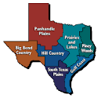
Thank You

