Slide 1
EPA Farmworker Protection
Diego Garcia
Pesticides Section
EPA R6 Land, Chemicals & Redevelopment Division August Farmworker Coalition Meeting August 23, 2023

Slide 2
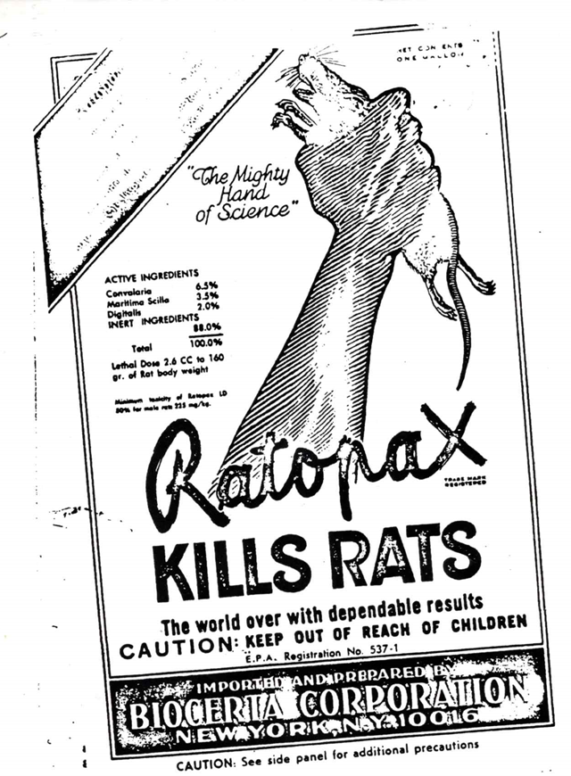
Quick History
1947
Federal Insecticide, Fungicide and Rodenticide Act was enacted
1970
EPA created by Richard Nixon to protect human health and the environment
EPA authorized to implement FIFRA
1974
EPA issued a Worker Protection Standard
1992
WPS was updated after determining it did not adequately protect farmworkers
2015
WPS was revised again.
2020
New provisions for AEZ requirements proposed
2023
Notice of proposed rulemaking to reconsider 2020 AEZ requirements.
The very first EPA pesticide label accepted in 1973

Slide 3
FIFRA
Federal Insecticide, Fungicide and Rodenticide Act (FIFRA) provides for federal regulation of pesticide distribution, sale, and use. Some EPA requirements under FIFRA are:
Labeling of pesticides and devices
Registration of pesticides
Minimizing Effects to the environment
EPA uses FIFRA to protect human health and the environment from adverse effects of pesticide use.
Notes:
Pesticides are essential for food production and pest control and out goal is to reap these benefits whilst ensuring the adverse effects are minimized and controlled.

Slide 4
Primacy
State agencies enter into cooperative agreements with EPA for the enforcement of Pesticide Use laws.
State Leading Agencies are granted primary enforcement responsibility for pesticide use violations.
Agencies are required to enforce FIFRA and perform inspections including Worker Protection Standard (WPS) inspections.
It does not mean they have sole responsibility.
Notes:
However, we at EPA can’t do it by ourselves so FIFRA gives Primacy to State leading agencies that enter into a cooperative agreement with EPA.

Slide 5
Pesticides
Notes:
So what is a pesticide?

Slide 8
Pesticides
Section 2(u) of FIFRA: Any substance or mixture of substances intended for preventing, destroying, repelling or mitigating any pest; or any substance or mixture of substances intended for use as a plant regulator, defoliant, or desiccant …–
The term ‘‘pest’’ means (1) any insect, rodent, nematode, fungus, weed, or (2) any other form of terrestrial or aquatic plant or animal life or virus, bacteria, or other micro-organism (except viruses, bacteria, or other micro-organisms on or in living man or other living animals)
The Administrator can declare a pest under FIFRA Section 25(c)(1)
Notes:
EPA considers a substance to be intended for a pesticidal purpose if the person who distributes or sells the substance states or implies that the substance can or should be used as a pesticide or that the product consists of, or contains, an active ingredient and that it can be used to manufacture a pesticide. EPA also considers a substance to be a pesticide if it consists of one or more pesticidal active ingredients and it has no significant commercially valuable use as distributed and sold except as a pesticide or for use to manufacture a pesticide. Finally, EPA considers a substance to be a pesticide if the person who distributes or sells it has actual or constructive knowledge that the substance will be used or is intended to be used as a pesticide.

Slide 9
Pesticides
PESTICIDE USE IN US
About 1 billion pounds of conventional pesticides are used each year in the United States to:
control weeds,
insects,
and other pests
The use of pesticides has resulted in a range of benefits,
increased food production
reduction of insect-borne disease,
Possible adverse effects on human health and environment, including water quality.*
Notes:
Here in the US …
From USGS in 2017
https://www.usgs.gov/centers/ohio-kentucky-indiana-water-science-center/science/pesticides#:~:text=About%201%20billion%20pounds%20of,%2C%20insects%2C%20and%20other%20pests.

Slide 10
Worker Protection Standard

Slide 11
WPS
The WPS is designed to protect agricultural workers and pesticide handlers from potential exposure to pesticides in agricultural settings. It applies to farms, forests, nurseries, and greenhouses where agricultural use pesticides are used in the production of agricultural plants.
WPS is very specific but it doesn’t mean that a circumstance that doesn’t fall under it has no protections for workers, the Label has to be followed.

Slide 12
WPS
Key provisions of the WPS include:
Notification: Employers are required to notify workers about pesticide-treated areas and provide specific information about the pesticides being used, such as the product name, active ingredients, and restricted-entry intervals.
Training: Employers must provide workers with training on pesticide safety, including topics such as pesticide hazards, proper handling and use, personal protective equipment (PPE), and decontamination procedures.

Slide 13
WPS
Restricted-entry intervals (REIs): REIs are established to minimize worker exposure to pesticides. Employers must ensure that workers do not enter pesticide-treated areas during the specified REI, unless they have received specific training and are wearing the appropriate PPE.
Personal Protective Equipment (PPE): Employers must provide and ensure the proper use of PPE, such as gloves, coveralls, and respirators, to protect workers from pesticide exposure.

Slide 14
WPS
Decontamination and Washing Facilities: Employers are required to provide adequate decontamination and washing facilities, including clean water, soap, and towels, to allow workers to remove pesticides from their bodies and clothing.
Hazard Communication: The WPS mandates that employers display warning signs in treated areas and provide access to safety information, such as Safety Data Sheets (SDS), to inform workers about the potential hazards associated with the pesticides being used.

Slide 15
WPS
Recordkeeping: Employers must maintain records related to pesticide applications, training, and other WPS compliance measures.
Retaliation: Employers cannot intimidate, threaten, coerce, discriminate against, prevent, discourage or fire any worker or handler from complying with the WPS. Employers cannot prevent or discourage compliance with the WPS through intimidation, coercion, discrimination or threat of firing.

Slide 16
WPS
The WPS aims to protect agricultural workers and pesticide handlers by ensuring they have the necessary information, training, and protective measures to minimize their exposure to pesticides and maintain a safe working environment.
The WPS protects agricultural employees regardless of their legal status

Slide 17
Designated Representative and Texas Worker Protection Law
Gives the workers the right to:
receive crop sheets from covered employers;
be informed about pesticides applied to the fields where they will be working;
name an individual or organization to represent an individual worker when trying to obtain pesticide information from the covered employer;
obtain a list of pesticides used at the workplace from the employer; and
not be disciplined or punished in any way for exercising their rights.
Notes:
A designated representative is a person or organization to whom an agricultural worker gives written authorization to exercise the worker's rights under this law. A designated representative may become certified by submitting a request to TDA
The workplace chemical list (WCL) is a record that covered employers must keep of all applications made at the workplace in excess of the threshold amount. All applicable crop sheets and the corresponding MSDS for each chemical listed must accompany the WCL as an attachment. TDA provides a form on which these records may be kept. The employer must maintain these records for 30 years or send them to TDA headquarters annually.
Covered employers are required to allow workers they employ or their representatives to view the WCL and attachments. Additionally, members of the surrounding community will have access to the list. A member of the community is defined as a person who works, lives, goes to school, stays in a nursing home or hospital within 1/4-mile of the covered employer's workplace.

Slide 18
How to Report a Pesticide Incident Involving Exposures to People
Call the state pesticide regulatory agency pertaining to the location of the incident, especially if you are concerned about a possible illegal use of a pesticide. States generally have primary enforcement responsibility for pesticide misuse violations and for investigating possible instances of pesticide misuse.

Slide 19
How to Report a Pesticide Incident Involving Exposures to People
A person involved in a pesticide exposure may want to start by calling the National Pesticide Information Center (NPIC) at 1-800-858-7378 to find out more about reporting pesticide exposure or illness. NPIC also provides summary reports to EPA on incidents, but does not collect information for enforcement nor do they provide EPA with any personal identifying information.

Slide 20
How to Report a Pesticide Incident Involving Exposures to People
Many labels contain a phone number to call in an emergency.
National Pesticide Information Center (NPIC)
EPA Cooperative Agreement Grantee – http://npic.orst.edu/ or Mon – Fri 10:00 AM to 2:00 PM CST at 1-800-858-7378
Find out objective, science based info about pesticides, and pesticide-related topics to enable informed decisions.
Have the product label with you when you call either number. The label provides those helping you with important information about the product.

Slide 21
Farmworker Protection Projects in Region 6
Labor Workers Rights Conference in El Paso, Texas
Grant awarded to the PEHSU
Outreach Materials
Future Farmworker Safety meeting early next year
Worker Protection Inspection Training for state agencies
Our goal is to continue creating relationships with farmworker groups to advocate for farmworker protection and safety

Slide 22
CONTACT INFO: Diego Garcia Garcia.diego01@epa.gov 214-665-2292 https://www.epa.gov/pesticide-worker-safety

